Slide 1


DEPARTMENT OF COMPUTER SCIENCE & ENGINEERING
SCHOOL OF COMPUTING
10214CS602 MINOR PROJECT –II
INDUSTRY PROJECTS
WINTER SEMESTER(2023-2024)
SEMESTER END PROJECT VIVA VOCE EXAMINATIONS
“X-Ray Analysis of Palm and Fingers for Fracture Detection ”
SUPERVISED BY
PRESENTED BY
Dr. M.SARAVANA KARTHIKEYAN M.E.,M.B.A.,Ph.D.,
ASSISTANT PROFESSOR - SENIOR GRADE
1. BOJJA.YASWANTHKUMARREDDY (VTU 23983)(21UEID0500)
2. VIPRAPATNAM VENKATARAO (VTU 23998)(21UECS0750)
3. MUNDRU SAI SANDEEP (VTU 24052)(21UECS0502)

Slide 2
OVERVIEW
ABSTRACT
OBJECTIVE
INTRODUCTION
LITERATURE REVIEW (SOFT COPY OF PAPERS TO BE LINKED AS HYPERLINK)
DESIGN AND METHODOLOGIES
IMPLEMENTATION
TESTING
INPUT AND OUTPUT
INCLUDE DEMO VIDEO (You Tube URL of complete demonstration of project by All members as Voice over)
CONCLUSION
FUTURE ENHANCEMENTS
SOCIETAL IMPACT OF PROJECT
WEB REFERENCES LINK (TILL REVIEW DATE ALL LINKS TO BE INCLUDED DAY WISE)
PLAGIARISM REPORT OF PROJECT REPORT AND PPT
POSTER PRESENTATION
JOURNAL/CONFERENCE PUBLICATION PROOF
REFERENCES

Slide 3
ABSTRACT
The Majority of bones that have fractured in humans are hand bones. As we use our hands widely, they need early and accurate detection to be diagnosed.
Fractures in the hands are most frequently brought on by blunt force trauma, sports injuries, and bone fragility.
Getting an X-ray of the affected area of the bone and then discussing the results with a medical practitioner or radiologist is the standard procedure for determining whether or not a fracture exists in the bone.
The majority of medical professionals and radiologists use X-rays to diagnose hand fractures; however, in some instances, they might miss small or hairline fractures.
Additionally, it might be difﬁcult to ﬁnd a good radiologist who can detect the fracture properly and in time, because a delay in diagnosis can cause the injury to be more severe, and the bone might not be recovered properly.
Therefore, to detect hand bone and joint fractures through X-rays, a hybrid model was developed that uses deep learning algorithms YOLO NAS, Efﬁcient Det, and DETR3, which are widely recognized for their exact object detection capabilities.
To evaluate the performance the best method is to compare the proposed model with the existing models, hence, the model was compared with various existing algorithms and result analysis was done

Slide 4
OBJECTIVES
AIM OF THE PROJECT:
The aim of the project on X-ray analysis of the palm and fingers for fracture detection is to develop an efficient and accurate diagnostic methodology for identifying and assessing fractures in the bones of the hand.
This includes utilizing advanced imaging techniques to capture clear images of the palm and fingers, conducting detailed analyses to detect fractures, and correlating findings with clinical presentations to confirm diagnoses.
The project seeks to enhance the accuracy and reliability of fracture detection in the hand, improve patient outcomes through appropriate and timely treatment, and provide a foundation for future advancements in diagnostic imaging of hand injuries.
SCOPE OF THE PROJECT :
The scope of the project on X-ray analysis of the palm and fingers for fracture detection encompasses a comprehensive approach to diagnosing and evaluating hand injuries
It includes optimizing imaging protocols to obtain clear and consistent X-ray images from various angles, such as anteroposterior, oblique, and lateral views.
he project aims to establish methods for detecting and classifying different types of fractures, including transverse, oblique, spiral, comminuted, and hairline fractures, as well as assessing soft tissue damage and joint involvement.
Advanced imaging techniques, such as digital X-rays and 3D reconstruction, may be explored to enhance visualization and analysis.

Slide 5
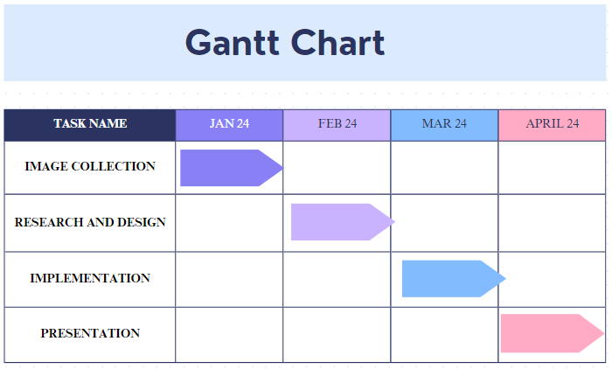
TIMELINE OF THE PROJECT

Slide 6
INTRODUCTION
X-ray analysis of the palm and fingers is a critical diagnostic tool in medical imaging, providing high-resolution visualization of hand structures for the assessment of fractures and other bone-related injuries.
This method employs electromagnetic radiation to produce images of the skeletal anatomy, offering detailed insights into the integrity and alignment of the bones, as well as potential soft tissue damage.
Through a series of standard views, including anteroposterior, oblique, and lateral projections, clinicians can identify and classify fractures based on their location, type, and severity.
The use of X-ray analysis facilitates accurate diagnosis, informed treatment planning, and effective monitoring of healing progress. With advances in imaging technology, such as digital X-rays and 3D reconstruction, the quality and precision of these analyses continue to improve.
Computer aided diagnosis (CAD) is a computer-based technology for clinicians to reduce their workload and improve their efficiency. In medical image analysis, CAD helps clinicians with suggestions made by algorithms in tasks of classification, detection and segmentation.
Radiologists diagnose various fractures through visual inspection of X-ray radiographs, which is a time-consuming and laborious process.
In addition, the shortage of clinicians in areas with insufficient medical resources, lack of professional radiologists in busy clinical environment, or radiologists’ fatigue due to heavy workload may cause false detection and terrible treatment of fracture In recent years, a couple of studies used deep learning (DL) methods to analyze the images of fracture sites.
Those studies were aimed not only at identifying and locating the fracture sites but assessing and predicting the fracture risks as well. Kim et al. proposed an algorithm for automatic segmentation of lumbar vertebra from X-ray images by combining DL techniques and level-set methods.

Slide 7
LITERATURE REVIEW
Author’s Name | Paper name and publication details | Year of publication | Main content of the paper
R. S. Prihatini | Proc. - 2020 IEEE 9th Int. Conf. Commun. Syst. Netw. Technol. CSNT | 2020 | Texture analysis and fracture identification of lower extremity bones X-ray images
L. Nascimento | Int. Conf. Electr. Eng. Comput. Sci. Informatics, vol. | 2015 | Computer aided bone fracture identification based on ultrasound images
R. Bagaria | Proc. - 2015 IEEE 4th Port. Meet. Bioeng. ENBENG | 2018 | Different techniques for identification of a bone fracture in analysis of medical image
L. Wang | Proc. - Int. Symp. Biomed. Imaging, vol. | 2019 | Automatic recognition of pertrochanteric bone fractures in femur using level sets

Slide 8
DESIGN AND METHODOLOGIES
MODULE 1: DATA COLLECTION AND MANIPULATION
MODULE 2: Convolutional Neural Networks(CNNs) algorithm

Slide 9
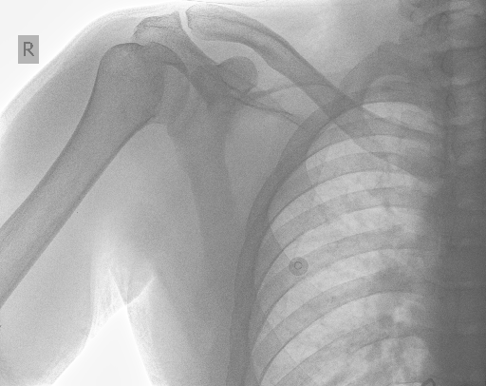
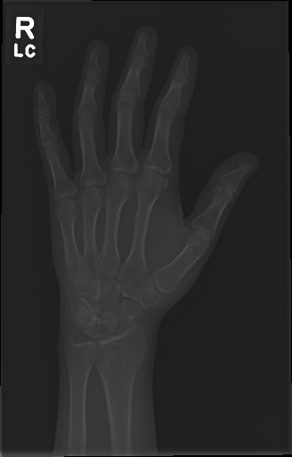
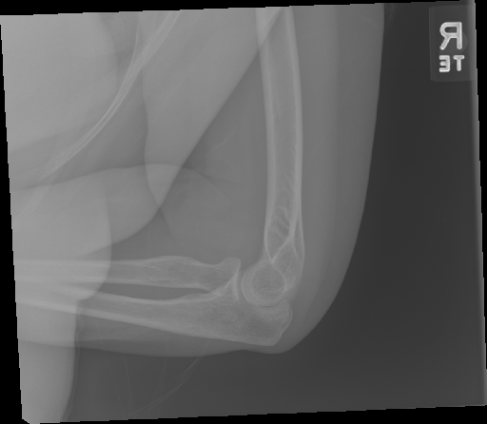
MODULE 1:DATA COLLECTION AND MANIPULATION
Step:1 Collection of data

Slide 10
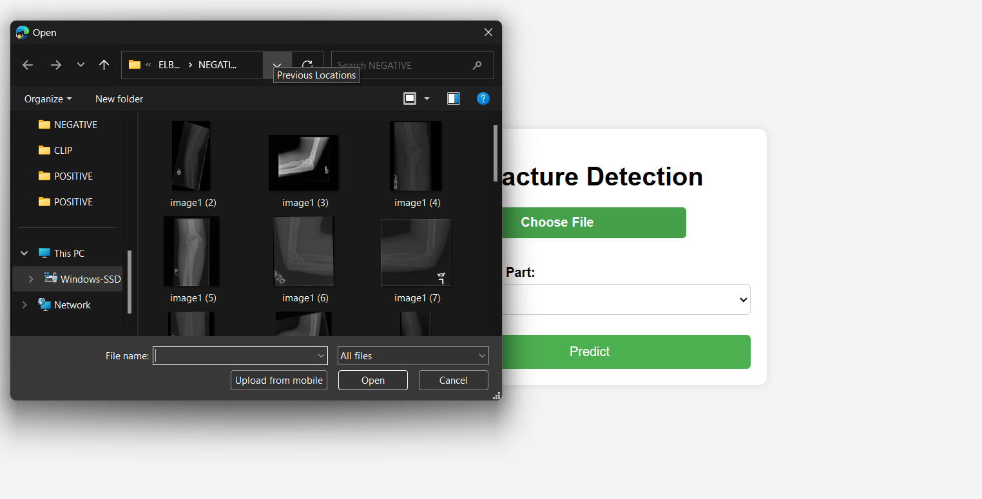
Step 2: Processing the data

Slide 11
Module 2- Convolutional Neural Networks(CNNs) algorithm
Convolution Neural Network (CNN) is especially valuable for spatial information examination, picture acknowledgment, PC vision, characteristic language handling, signal preparing, and an assortment of other various purposes.
They are organically inspired by the working of neurons in the visual cortex to a visual upgrade. What makes CNN significantly more impressive contrasted with the other criticism forward organizations for picture acknowledgment is the way that they don't need as much human mediation and boundaries as a portion of different organizations, for example, MLP do.
CNNs are trained by gradient-based optimization techniques like backpropagation, which iteratively adjusts the network parameters (weights and biases) to minimize a predetermined loss function. During training, the network learns to extract key features from incoming data and generate accurate predictions about previously unseen samples.
This is principally determined by the way that CNN's have neurons organized in three measurements. CNN's make the entirety of this sorcery occur by taking a bunch of info and giving it to at least one of the accompanying fundamental concealed layers in an organization.
Convolution Layers
Pooling Layers
Fully Connected Layers

Slide 12
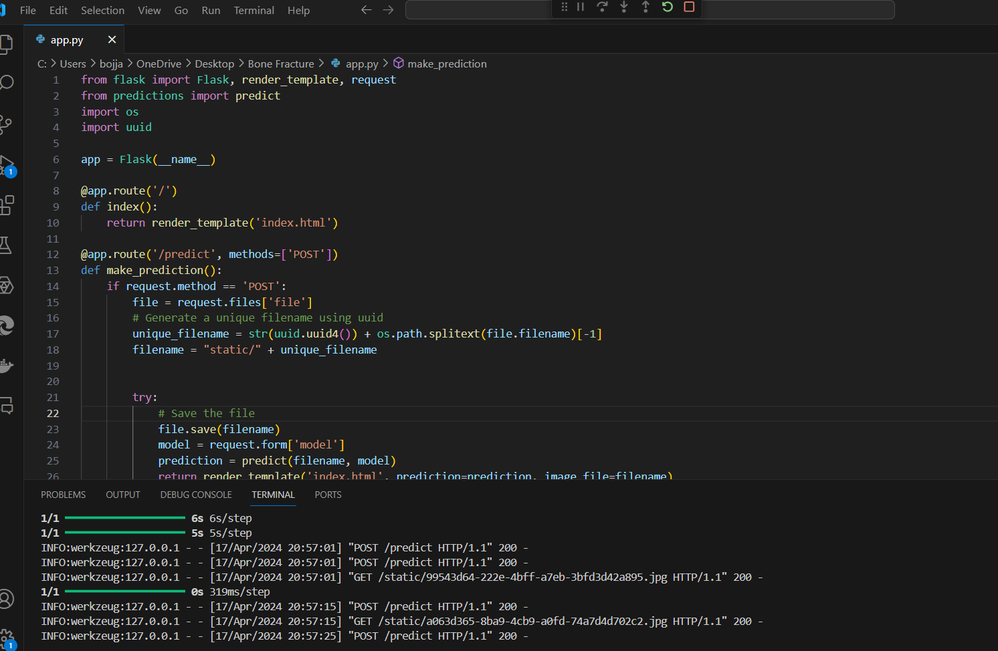
Step 3: CNN ALGORITHM

Slide 13
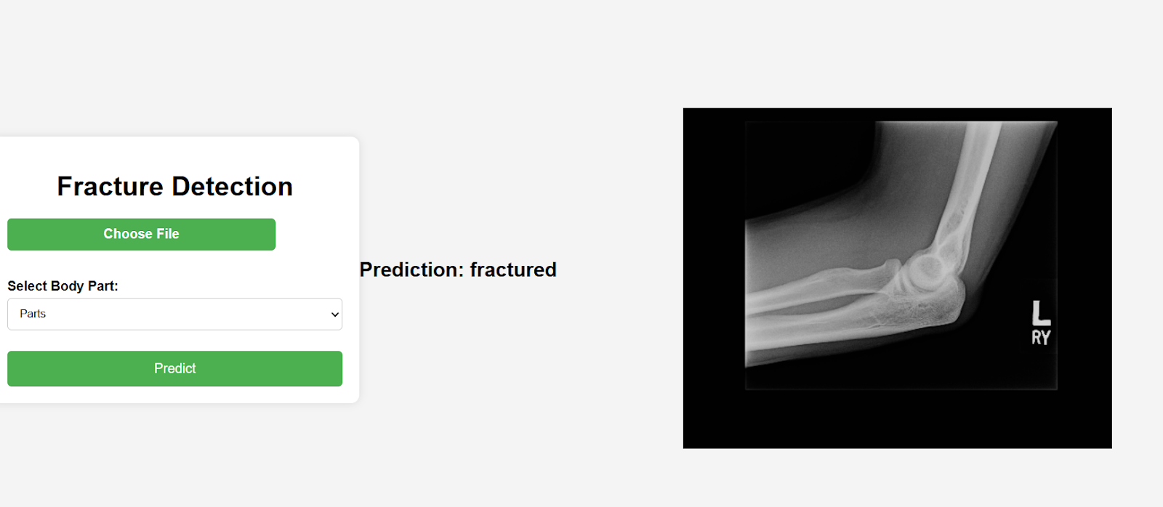
Step 4: The output
After uploading a hand X-ray image to the system, the deep learning model examines it and automatically detects any fractures in the palm and fingers.

Slide 14
IMPLEMENTATION
Architecture Diagram
Data –Flow Diagram
Use Case Diagram
Class Diagram
Activity Diagram
Sequence Diagram
Collaboration Diagram(If applicable)
E-R Diagram

Slide 15
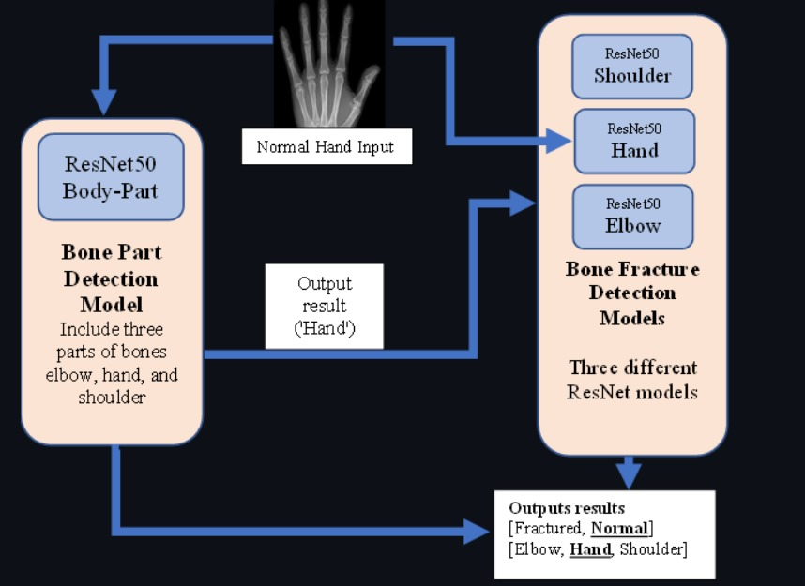
Architecture Diagram
The sequential flow of information across many levels. Raw input data, such as photographs, is fed into the network first, via the Input Layer. The Convolutional Layers extract features from this data, which is then transformed nonlinearly using Activation Functions. Pooling Layers then down sample the feature maps while keeping critical information.
The processed data is then sent into Fully Connected Layers for classification or regression tasks. Finally, the output layer generates the network's predictions.
. This graphic depicts how input data is gradually changed and processed by the CNN's layers, ultimately resulting in correct predictions or outputs

Slide 16
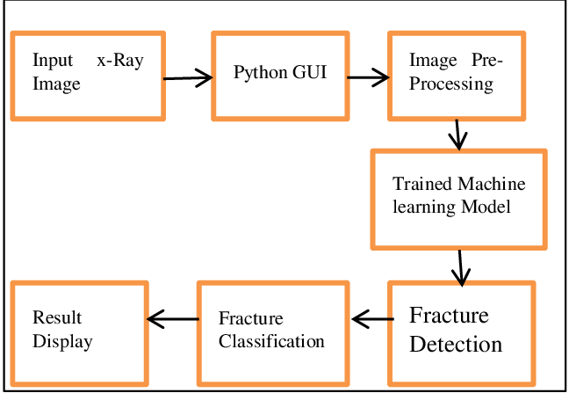
Data –Flow Diagram
A data flow diagram (DFD) for fracture detection outlines the sequence and processing of data in a system designed to detect fractures in a specific object, such as bones in medical imaging. The system begins with acquiring sensor data from various imaging modalities such as X-ray.
Once the data is collected, it undergoes preprocessing to improve quality and enhance features for analysis, including noise reduction and contrast enhancement. The enhanced image data is then analyzed using image segmentation and feature detection techniques to identify potential fractures and classify them based on type and severity.
This analysis informs the generation of comprehensive reports that provide detailed insights into detected fractures, including their locations and characteristics.

Slide 17
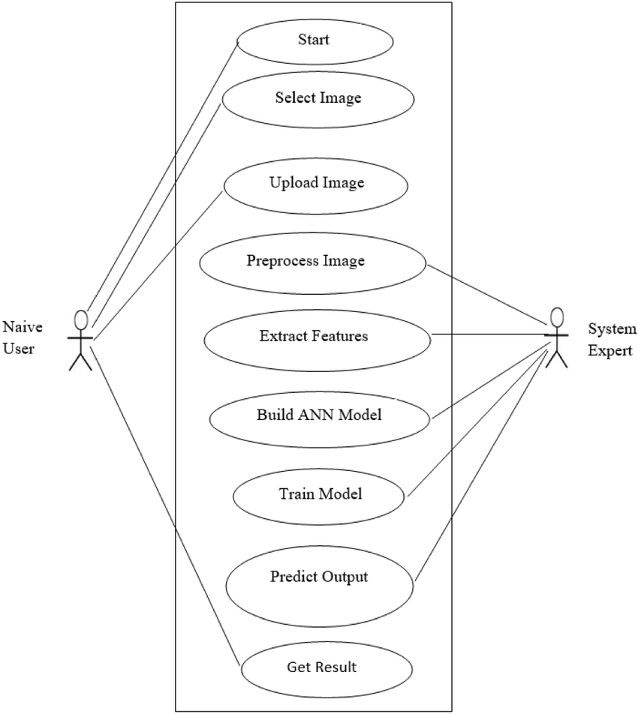
Use Case Diagram
A use case diagram for fracture detection presents the interactions between users (actors) and the system to achieve specific objectives in identifying fractures. In this context, actors typically include radiologists, medical technicians, and sometimes patients.
The use case diagram illustrates key functions such as capturing imaging data, where medical technicians operate imaging equipment to obtain X-ray, CT, or MRI scans of the area of interest.
Radiologists can then interact with the system to analyze preprocessed images, identifying potential fractures using advanced image analysis tools. Another important use case involves generating a comprehensive report for medical professionals, detailing the location, severity, and type of detected fractures, along with recommended courses of action.
Additionally, the system may provide real-time alerts or notifications to radiologists or medical teams if critical fractures are detected. Patients may also be involved indirectly through receiving information or alerts about their medical status.

Slide 18
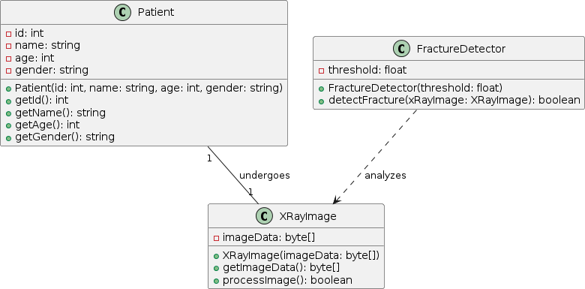
Class Diagram
A class diagram for fracture detection in medical imaging systems outlines the structural relationships between different classes and their attributes and methods in the context of identifying fractures. Core classes in the system may include ImageData, representing medical images such as X-rays, MRI scans, or CT scans, and encapsulating attributes such as image quality and resolution.
The Fracture class stores information about detected fractures, including location, type, and severity. The Patient class contains patient-specific data, such as medical history, age, and gender, which can influence the detection and analysis process.
To support fracture detection, the system includes classes such as ImageProcessor, which offers methods to preprocess images (e.g., noise reduction, enhancement) and segment potential areas of interest
The FractureDetector class provides methods to analyze preprocessed images and identify fracture characteristics.

Slide 19
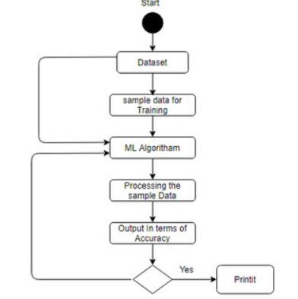
Activity Diagram
An activity diagram for fracture detection in a medical imaging system outlines the sequential workflow and decision-making processes involved in identifying fractures.
The diagram begins with obtaining medical imaging data such as X-rays, MRI, or CT scans from the patient. These images are then preprocessed to enhance quality and remove noise, ensuring optimal conditions for analysis.
Once preprocessing is complete, the enhanced images proceed to the analysis stage, where advanced algorithms or trained radiologists examine the images for signs of fractures.
This involves segmentation of the image to identify potential areas of interest, followed by fracture feature extraction and classification based on type and severity.
If fractures are detected, the activity flow branches depending on the severity and location. For critical fractures, the system triggers alerts to notify healthcare providers for immediate attention.
Simultaneously, the detected fractures and their characteristics, along with relevant patient data, are compiled into a comprehensive diagnostic report.

Slide 20
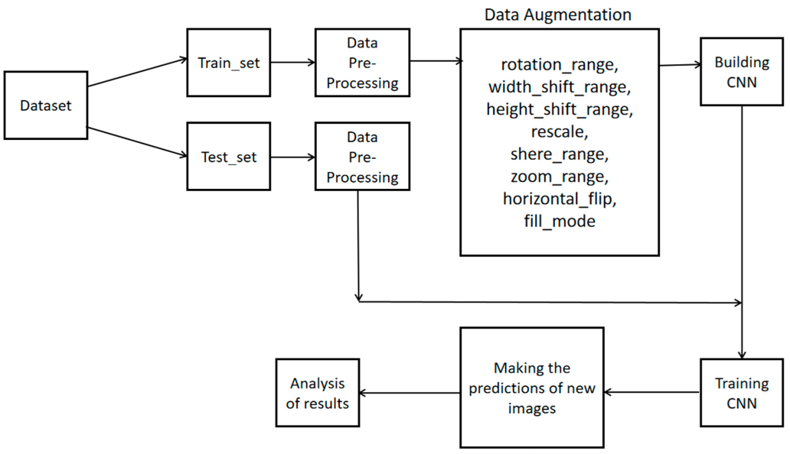
Sequence Diagram
A sequence diagram for fracture detection illustrates the interactions between various components in the system and their chronological sequence when identifying fractures in medical imaging data. It begins with a medical imaging device (such as an X-ray, MRI, or CT scanner) capturing images of the patient's area of interest.
The images are then sent to the system's ImageProcessor component, which preprocesses them to improve quality and enhance features, such as removing noise and adjusting contrast.Next, the preprocessed images are passed to the FractureDetector component, which applies image analysis algorithms to identify potential fractures.
This process involves segmenting the image, detecting fracture features, and classifying the findings based on type and severity. If fractures are detected, the system may route critical fracture information to the AlertSystem component, which notifies healthcare providers of urgent cases requiring immediate attention.
Simultaneously, the detected fractures and their details, such as location and severity, are sent to the ReportGenerator component.

Slide 21
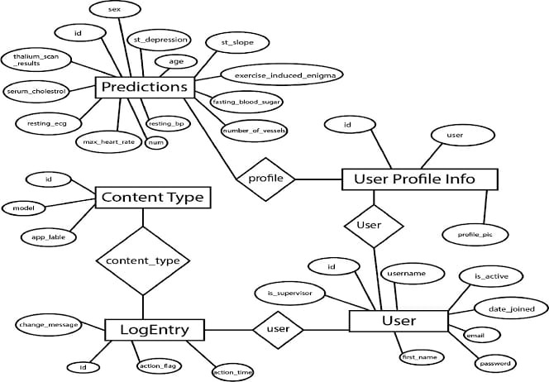
E-R Diagram
An Entity-Relationship (ER) diagram for fracture detection could include entities such as "Patient," "X-Ray Image," "Fracture," and "Physician." The relationships between these entities could be represented as "Patient undergoes X-Ray," "X-Ray Image detects Fracture," and "Physician diagnoses Fracture." Attributes for each entity would include details like patient ID, X-Ray image ID, fracture location, and physician ID. This structure helps visualize how data flows within the fracture detection process.

Slide 22
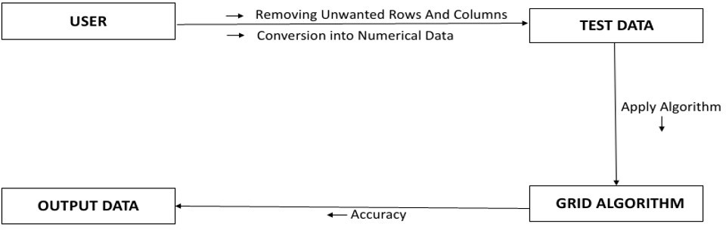
Collaboration Diagram(If applicable)
A collaboration diagram for fracture detection would illustrate the interactions between various components involved in the process. It could depict entities such as "Patient," "Radiology Department," "Fracture Detection Algorithm," and "Physician." The diagram would show the flow of information and actions, such as the patient undergoing an X-Ray.
The X-Ray image being processed by the Fracture Detection Algorithm, and the results being reviewed and diagnosed by the Physician. Each component's responsibilities and interactions would be clearly delineated, aiding in the understanding of the fracture detection workflow.

Slide 23
TESTING
UNIT TESTING
INTEGRATION TESTING
FUNCTIONAL TESTING
WHITE BOX TESTING
BLACK BOX TESTING

Slide 24
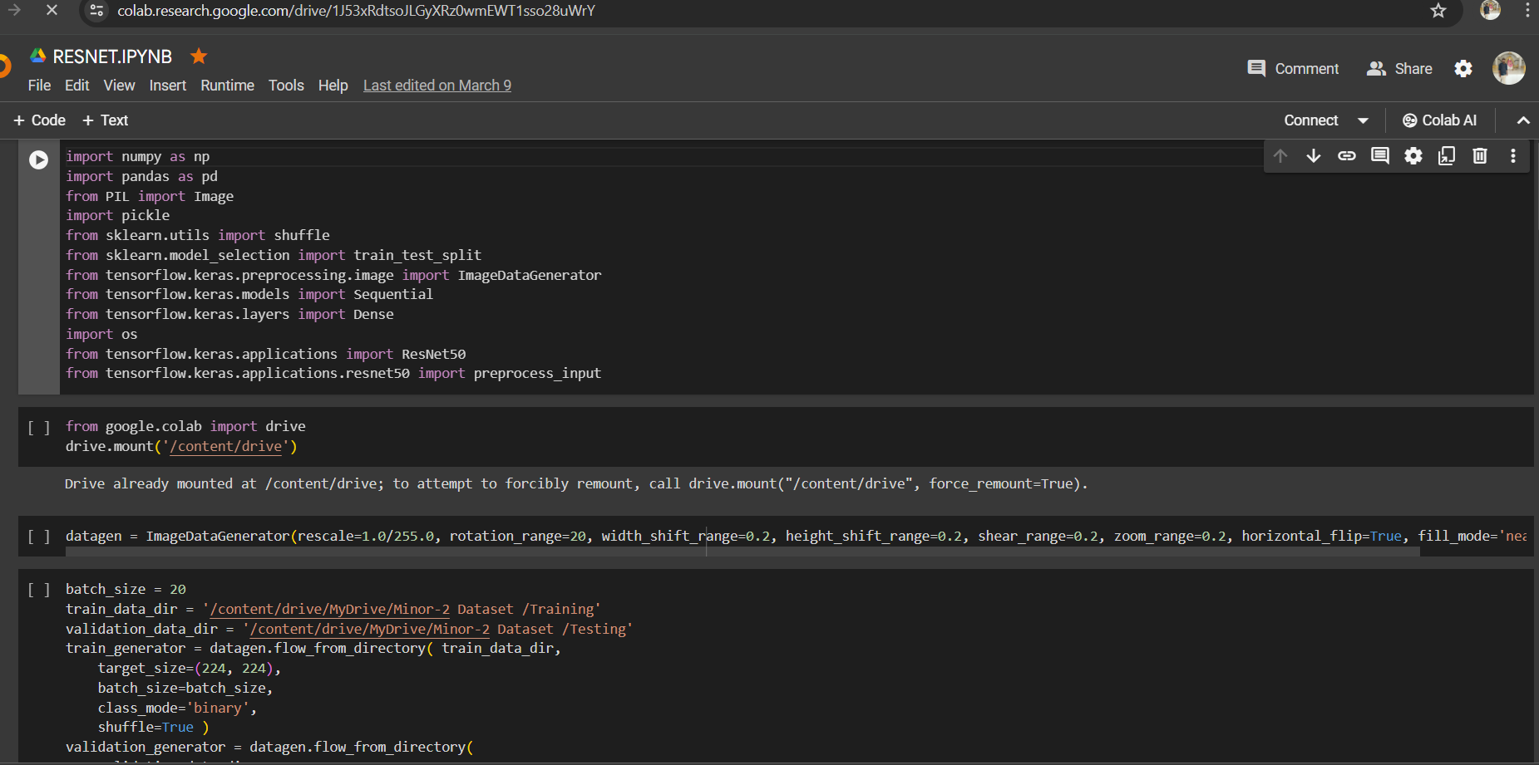
UNIT TESTING
Unit testing involves testing individual components of the software program or application. The main purpose behind this is to check that all the individual parts are working as intended. A unit is known as the smallest possible component of software that can be tested.

Slide 25
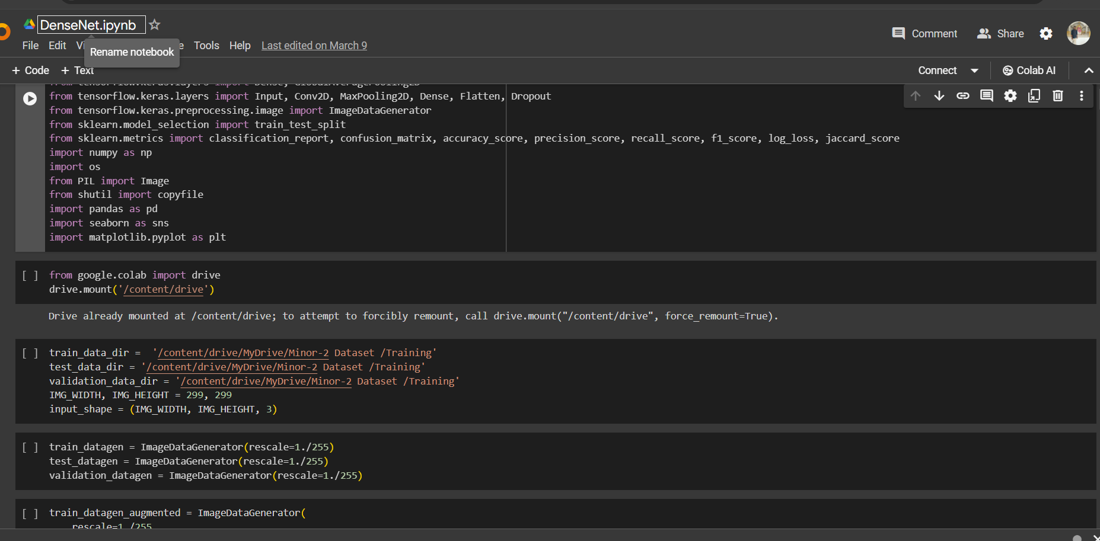
INTEGRATION TESTING
Software components are gradually merged and then tested as a cohesive group in an approach known as integration testing.

Slide 26
FUNCTIONAL TESTING
One sort of testing called functional testing looks to determine if every component of the programme functions in accordance with the requirements of the software.

Slide 27
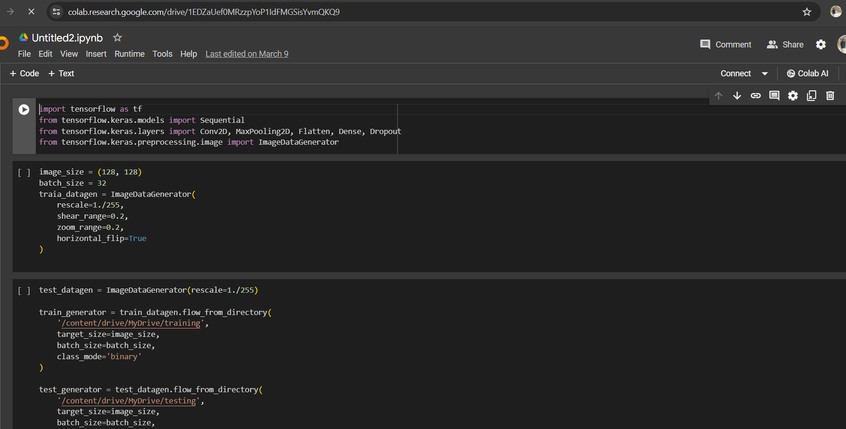
SYSTEM TESTING
Testing an entire, fully integrated software product is known as system testing.

Slide 28
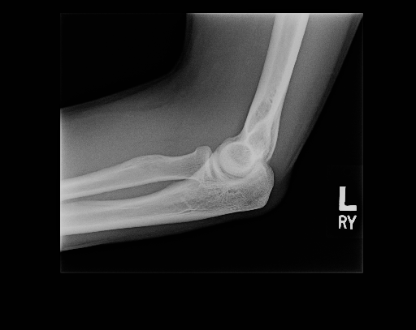
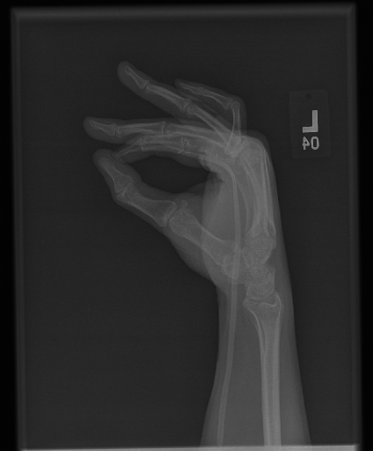
INPUT AND OUTPUT

Slide 29
SOURCE CODE

Slide 30
CONCLUSION
In conclusion, effective fracture detection is paramount for accurate diagnosis and treatment planning in orthopedic medicine. Utilizing advanced imaging techniques such as X-rays, CT scans, and MRI scans, along with emerging technologies like artificial intelligence, clinicians can enhance their ability to identify and classify fractures promptly and precisely.
This not only improves patient outcomes by facilitating timely interventions but also minimizes the risk of complications associated with undetected or misdiagnosed fractures. Continued research and technological advancements in fracture detection hold promise for further optimizing diagnostic accuracy and patient care in the field of orthopedics.
Moreover, these advancements have the potential to streamline workflows, reduce healthcare costs, and enhance the efficiency of fracture management protocols. Looking ahead, ongoing research and collaboration between medical professionals and technologists promise to push the boundaries of fracture detection even further, ultimately benefiting patients worldwide.

Slide 31
Step 4: The output
After uploading a hand X-ray image to the system, the deep learning model examines it and automatically detects any fractures in the palm and fingers.

Slide 32
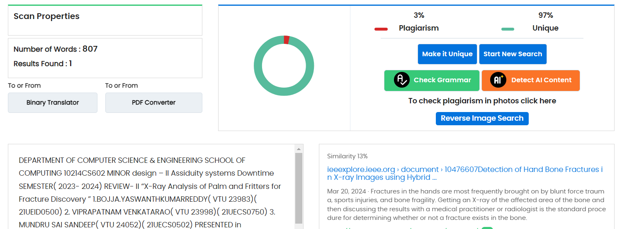
Plagiarism Report of PPT

Slide 33
Web references/video links
https://www.youtube.com/watch?v=H7zTauZjeUA
https://www.youtube.com/watch?v=ytugFiA0ELc
https://www.youtube.com/watch?v=KrurfmdXQlc

Slide 34
REFERENCES
[1] R. Bagaria, S. Wadhwani, and A. K. Wadhwani, “Different techniques for identification of a bone fracture in analysis of medical image,” Proc. - 2020 IEEE 9th Int. Conf. Commun. Syst. Netw. Technol. CSNT 2020, pp. 327–332, 2020, doi: 10.1109/CSNT48778.2020.9115760.
[2] R. S. Prihatini, A. H. Setyaningrum, and I. M. Shofi, “Texture analysis and fracture identification of lower extremity bones X-ray images,” Int. Conf. Electr. Eng. Comput. Sci. Informatics, vol. 2017-December, no. September, pp. 19–21, 2017, doi: 10.1109/EECSI.2017.8239113.
[3] L. Nascimento and M. G. Ruano, “Computer aided bone fracture identification based on ultrasound images,” Proc. - 2015 IEEE 4th Port. Meet. Bioeng. ENBENG 2015, no. February, pp. 26–28, 2015, doi: 10.1109/ENBENG.2015.7088892.
[4] Y. Cao, H. Wang, M. Moradi, P. Prasanna, and T. F. Syeda-Mahmood, “Fracture detection in x-ray images through stacked random forests feature fusion,” Proc. - Int. Symp. Biomed. Imaging, vol. 2015-July, pp. 801–805, 2015, doi: 10.1109/ISBI.2015.7163993.
[5] L. Wang, H. Cheng, H. Lan, Y. Zheng, and K. Li, “Automatic recognition of pertrochanteric bone fractures in femur using level sets,” Proc. Annu. Int. Conf. IEEE Eng. Med. Biol. Soc. EMBS, vol. 2016-October, pp. 3851–3854, 2016, doi: 10.1109/EMBC.2016.7591568.

Slide 35
[6]V. L. F. Lum, W. K. Leow, Y. Chen, T. Sen Howe, and M. A. Png, “Combining classifiers for bone fracture detection in x-ray images,” Proc. - Int. Conf. Image Process. ICIP, vol. 1, pp. 1149–1152, 2005, doi: 10.1109/ICIP.2005.1529959.
[7]V. L. F. Lum, W. K. Leow, Y. Chen, T. Sen Howe, and M. A. Png, “Combining classifiers for bone fracture detection in x-ray images,” Proc. - Int. Conf. Image Process. ICIP, vol. 1, pp. 1149–1152, 2005, doi: 10.1109/ICIP.2005.1529959.
[8]W. Zheng, N. Ma, H. Sun, and H. Fan, “Feature extraction of X-ray fracture image and fracture classification,” 2009 Int. Conf. Artif. Intell. Comput. Intell. AICI 2009, vol. 2, pp. 408–412, 2009, doi: 10.1109/aici.2009.40.
[9]Z. Wu, X. Mo, H. Zhou, L. Liu, and J. Li, “Classification of reservoir fracture development level by convolution neural network algorithm,” ICNC-FSKD 2018 - 14th Int. Conf. Nat. Comput. Fuzzy Syst. Knowl. Discov., pp. 243–250, 2018, doi: 10.1109/FSKD.2018.8687232.
[10]M. Lotfy, R. M. Shubair, N. Navab, and S. Albarqouni, “Investigation of Focal Loss in Deep Learning Models for Femur Fractures Classification,” 2019 Int. Conf. Electr. Comput. Technol. Appl. ICECTA 2019, pp. 2–5, 2019, doi: 10.1109/ICECTA48151.2019.8959770.

Slide 36
THANK YOU

